Slide 1

Implementation of Frequency Division Multiplexing using BASK Modulation and Demodulation in MATLAB: From Surname-to-Binary Conversion to Recovery and Verification

Slide 2

Objective
Simulate digital communication process for transmitting two surnames: DAS and BISWAS.
Convert each surname into binary vector (MSB-first).
Represent signals in time domain using unipolar NRZ.
Apply BASK modulation with different carriers (x1: 2 Hz, x2: 4 Hz).
Combine using FDM and add Gaussian noise.
Demultiplex, demodulate, and decode to verify recovered surnames.

Slide 3
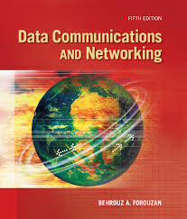
Theory
NRZ Signaling: Represents digital bits as voltage levels (1 → high, 0 → low).
BASK Modulation: Binary Amplitude Shift Keying – amplitude of carrier represents bit.
Frequency Division Multiplexing (FDM): Combine multiple signals with different carrier frequencies.
Demodulation: Recover original bits by multiplying with carrier and low-pass filtering.
ASCII Conversion: Binary → Characters to verify recovered surnames.
Include small diagram showing bit → NRZ → BASK → FDM → Demodulation → recovered bit → ASCII

Slide 4
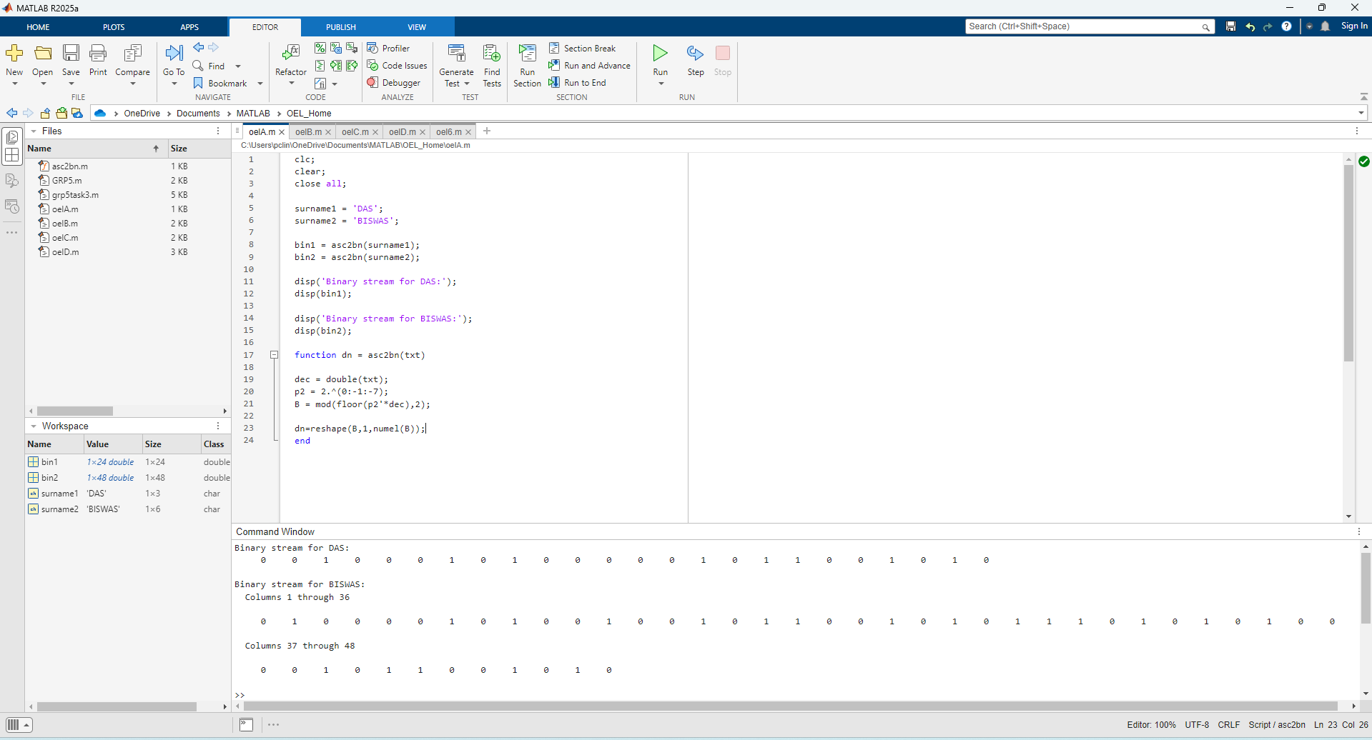

Task 1 – Generate Binary Vectors
Points:
Input surnames: x1 = DAS, x2 = BISWAS.
Converted to binary vectors using ASCII table (MSB-first).
Example:
DAS → 01000100 01000001 01010011
BISWAS → 01000010 01001001 01010011 01010111 01000001 01010011

Slide 5
Input: Surnames 'DAS' and 'BISWAS’.
Function: asc2bn converts text → ASCII → 8-bit binary
Output: Displays binary streams for both surnames

Slide 6
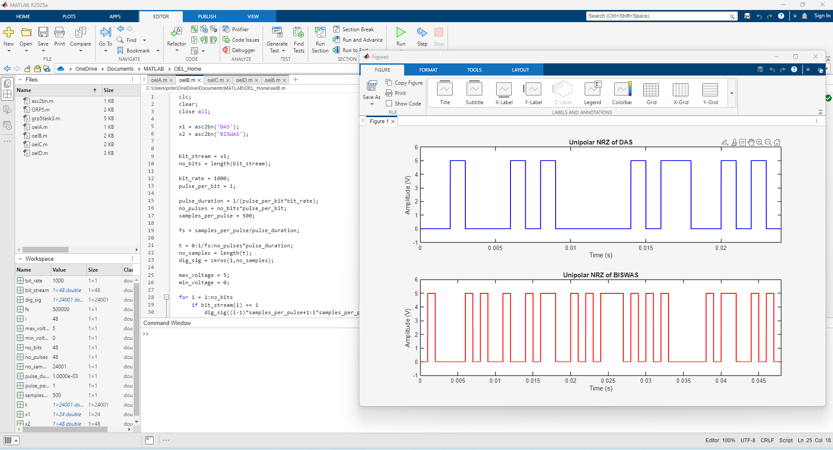
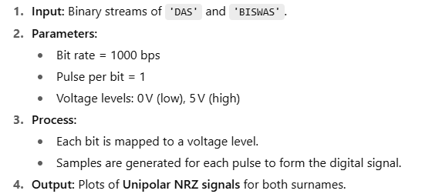
Task 2 – Represent in Time Domain (NRZ)

Slide 7
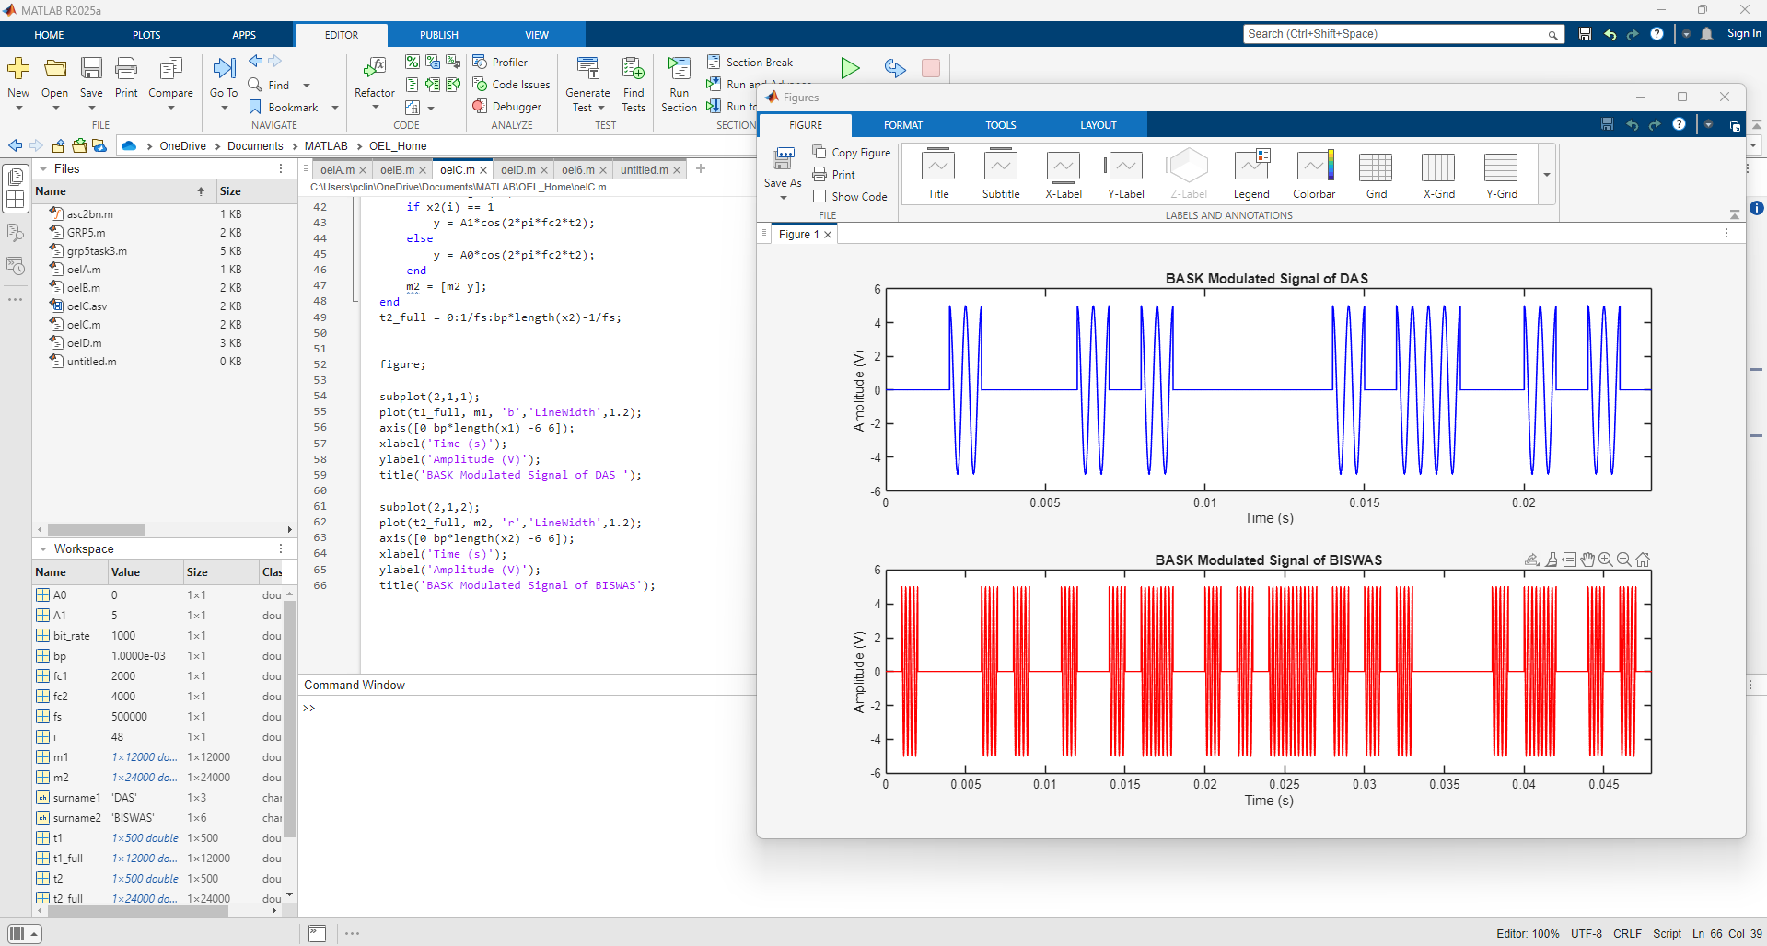
Task 3 – Apply BASK Modulation
x1 modulated with 2 Hz carrier, x2 with 4 Hz carrier.
High bit → carrier present (amplitude 5V), Low bit → no carrier. Successfully transmitted two surnames via BASK + FDM.
MSB-first encoding and decoding ensured correct recovery.
Noise (SNR = 15 dB) did not affect final output.
Demonstrates fundamental concepts of digital communication.

Slide 8
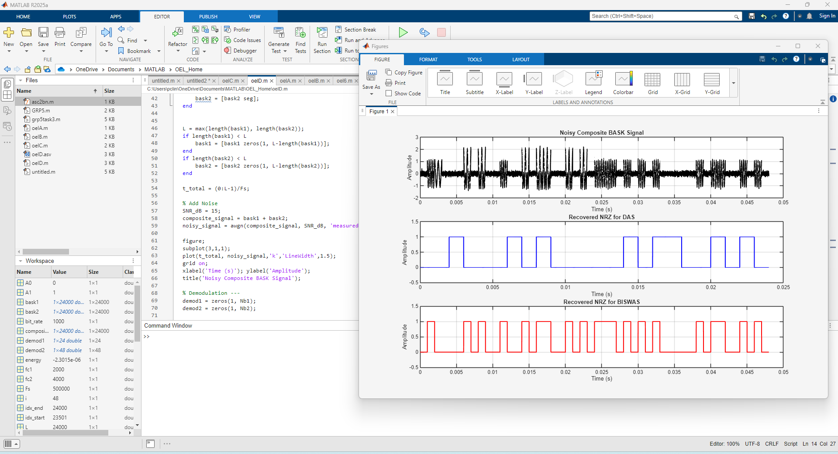
Task 4 – Frequency Division Multiplexing (FDM)
Input: Binary streams of 'DAS' and
'BISWAS'.
BASK Modulation:
Carrier frequencies: 2 kHz (DAS), 4 kHz (BISWAS)
Amplitude: 1 V for 1, 0 V for 0
FDM Composite: Signals are zero-padded, summed to form a composite signal.
Noise Addition: AWGN with 15 dB SNR added to the composite signal.
Output: Plot of noisy composite BASK signal

Slide 9
Task 5 – Demultiplexing and Demodulation
Multiply noisy signal with carrier
Detect bit energy and compare with threshold.
Rebuild NRZ signal from recovered bits.
Plot recovered NRZ for DAS (blue) and BISWAS (red).

Slide 10

Task 6 – ASCII Decoding and Verification
Convert surnames to binary (8-bit per character).
Reshape binary into 8-bit groups.
Convert binary back to decimal → ASCII characters.
Display original and recovered surnames.
Check if recovery is correct.
Output
Original Surnames: DAS BISWAS Recovered Surnames: DAS BISWAS Success: Surnames recovered correctly!

Slide 11

Results Analysis
NRZ signals correctly represented digital bits.
BASK modulation successful with proper carrier frequencies.
FDM combined signals effectively; noise caused small fluctuations but did not affect recovery.
Demodulation recovered exact binary sequences.
ASCII decoding verified successful transmission of DAS and BISWAS.

Slide 12

Successfully transmitted two surnames via BASK + FDM.
MSB-first encoding and decoding ensured correct recovery.
Noise (SNR = 15 dB) did not affect final output.
Demonstrates fundamental concepts of digital communication.

Slide 13

Advantages & Limitations
Advantages
Simple and clear demonstration of digital communication workflow.
Works with noisy channels (robust to moderate noise).
Illustrates NRZ, BASK, FDM, and ASCII encoding/decoding.
Limitations
Low carrier frequencies (2 Hz & 4 Hz) → not practical for real applications.
High sampling rate required for accurate NRZ/BASK plots.
Only two signals simulated; adding more increases complexity.

Slide 14


